Slide 1
CSCE 313 – Unix process scheduling
Reading Reference:
Textbook: Chapter 7
Aakash Tyagi CSCE 313 Spring 2016
February 23, 2016

Slide 2
Theme – What we have explored so far
We have seen how computer and operating systems have evolved, especially in doing multiple things at once (concurrency and parallelism)
We have talked about the separation of user application space, hardware, and the middle protective layer called Kernel
We have discussed how certain operations initiated by the user must be intercepted and furnished by the Kernel
We have also seen how the hardware IO devices get the attention of the Kernel to serve Interrupts
We have discussed the concept of a process (program in execution) and talked about how a process can create and execute a child process
Finally, we have seen what a process lifecycle looks like with the different stages a process can be in and its various transition modes

Slide 3
Theme – What we have explored so far
We have seen how computer and operating systems have evolved, especially in doing multiple things at once (concurrency and parallelism)
We have talked about the separation of user application space, hardware, and the middle protective layer called Kernel
We have discussed how certain operations initiated by the user must be intercepted and furnished by the Kernel
We have also seen how the hardware IO devices get the attention of the Kernel to serve Interrupts
We have discussed the concept of a process (program in execution) and talked about how a process can create and execute a child process
Finally, we have seen what a process lifecycle looks like with the different stages a process can be in and its various transition modes
preempt
Create
(new)
ready
running
Exit
(terminated)
dispatch
I/O or
Event complete
blocked
I/O or event wait

Slide 4
Theme – What are we moving on to next?
Today we will ask how does a Kernel juggle the (often) competing requirements of Performance, Fairness, Utilization, etc. in dealing with concurrency
Proc 1
Proc 2
Proc n
Kernel

Slide 5
Outline of Today’s Lecture
Scheduling policy: what to do next, when there are multiple processes ready to run
Or multiple packets to send, or web requests to serve, or...
Definitions
response time, throughput, predictability
Scheduling policies
FIFO, round robin, optimal
multilevel feedback queues as approximation of optimal
Adapted from contemporary courses in OS/Systems taught at Berkeley, UW, TAMU,
UIUC, and Rice. Special acknowledgment to Profs. Guo/Bettati at TAMU,
Joseph at Berkeley, Anderson & Dahlin (Chapter 7)

Slide 6
A Conversation about Scheduling
You manage a web site, that suddenly becomes wildly popular. Do you?
Buy more hardware?
Implement a different scheduling policy?
Turn away some users? Which ones?
How much worse will performance get if the web site becomes even more popular?
When does scheduling become important?
Multiple consumers
Diverse needs for shared resources
Consideration must be paid for a number of performance measures
Customer-Centric: Response Time (wait time + service time)
System-Centric: Response Time, Fairness, Throughput
Overarching Goal: Minimize Response time while maximizing throughput

Slide 7
A Conversation about Scheduling
How do these systems operate in real life –
Order counter at a fast food restaurant
Water server at a sit-down restaurant
Checkout counter at a supermarket
Notes:
At a fast food restaurant, a normal order is First-Come-First-Served. A wait staff serving water will likely pick a round-robin format. A checkout counter may implement a scheme where some lines may be “10 items or less” and some lines may be traditional first-come-first-served.

Slide 8
Terms and Definitions
Task/Job
User request: e.g., mouse click, web request, shell command, …
Latency/response time
How long does a task take to complete?
Throughput
How many tasks can be done per unit of time?
Overhead
How much extra work is done by the scheduler?
Fairness
How equal is the performance received by different users?
Predictability
How consistent is the performance over time?
Notes:
1. Minimize response time: elapsed time to do an operation (or job)
Response time is what the user sees: elapsed time to
echo a keystroke in editor
compile a program
run a large scientific problem
2. Maximize throughput: operations (or jobs) per second
Throughput is related to response time, but they're not identical -- for example, I’ll show that minimizing response time will lead you to do more context switching than you would if you were only concerned with throughput.
Two parts to maximizing throughput
a. Minimize overhead (for example, context switching)
b. Efficient use of system resources (not only CPU, but disk, memory, etc.)
What does CPU scheduling have to do with efficient use of the disk? A lot! Have to have CPU to make a disk request.
3. Fair: share CPU among users in some equitable way
Tradeoff: will argue you can get better average response time by making system less fair.
What does fairness mean?
Minimize # of angry phone calls? Minimize my response time?
Minimize average response time? We will argue fairness is a tradeoff against average response time; can get better average response time by making system less fair. Sort of like capitalism.
Anecdote: Response time has a lot to do with perceived effectiveness.
IBM keystroke experiment -- consistency is better than speed.
Might believe that since have PC's, CPU scheduling is less important -- usually, only one thing running at a time, for a single user. But! Face similar problems in networks -- how do you allocate scarce resources among users? Do you optimize for response time, throughput, fairness? In networks, fairness is often suboptimal.

Slide 9
More Terms and Definitions
Workload
Set of tasks for system to perform
Preemptive scheduler
If we can take resources away from a running task
Work-conserving
Resource is used whenever there is a task to run
Scheduling algorithm
takes a workload as input
decides which tasks to do first
Performance metric (throughput, latency) as output
Only preemptive, work-conserving schedulers to be considered

Slide 10
Schedulers
start
long-term (admission) scheduler
short-term (CPU) scheduler
suspended
ready
ready
running
suspended
blocked
blocked
medium-term (memory) scheduler
Notes:
Long-term scheduler (job scheduler)
controls degree of multiprogramming
must select a good process mix of I/O-bound and CPU-bound processes
Short-term scheduler:
allocates the CPU
executes at least every 100ms, therefore must be very fast
Medium-term scheduler (swapper):
in some OSs
sometimes good to temporarily remove processes from memory

Slide 11
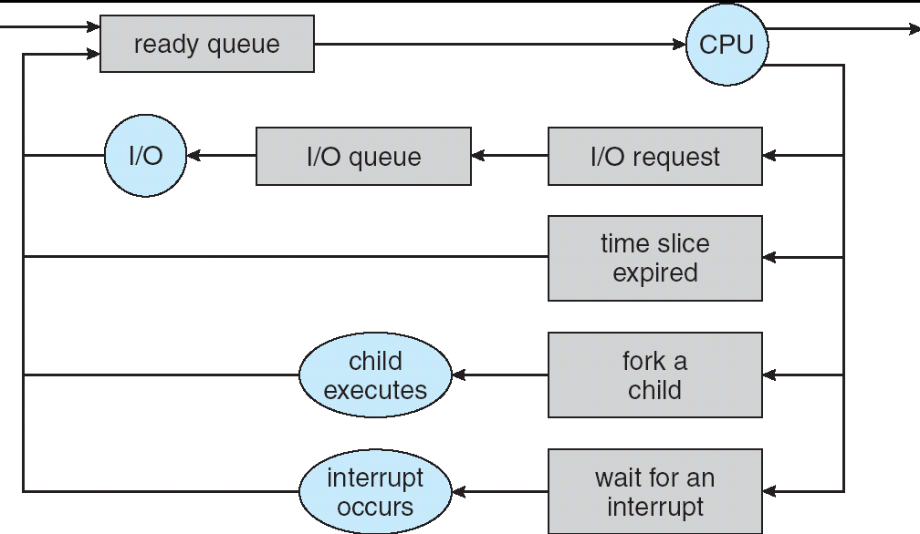
CPU Scheduling
Question: How is the OS to decide which of several processes to take off a queue?
Obvious queue to worry about is ready queue

Slide 12
Scheduling Assumptions
The high-level goal: Dole out CPU time to optimize some desired parameters of system
USER1
USER2
USER3
USER1
USER2
Time

Slide 13
Focus: Short-Term Scheduling
Recall: Motivation for multiprogramming -- have multiple processes in memory to keep CPU busy.
Typical execution profile of a process:
start
terminate
wait for I/O
wait for I/O
wait for I/O
CPU burst
CPU burst
CPU burst
CPU burst
CPU scheduler is managing the execution of CPU bursts, represented by processes in ready or running state.

Slide 14
Scheduling Metrics
Waiting Time: time the job is waiting in the ready queue
Time between job’s arrival in the ready queue and launching the job
Service (Execution) Time: time the job is running
Response (Completion) Time:
Time between job’s arrival in the ready queue and job’s completion
Response time is what the user sees:
Time to echo a keystroke in editor
Time to compile a program
Response Time = Waiting Time + Service Time
Throughput: number of jobs completed per unit of time
Throughput related to response time, but not same thing:
Minimizing response time will lead to more context switching than if you only maximized throughput
Notes:
What does CPU scheduling have to do with efficient use of the disk?
A lot! Have to have the CPU to make a disk request
Fairness: Minimize # of angry phone calls? Minimize my response time?

Slide 15
Scheduling Policy Goals/Criteria
Minimize Response Time
Minimize elapsed time to do an operation (or job)
Maximize Throughput
Two parts to maximizing throughput
Minimize overhead (for example, context-switching)
Efficient use of resources (CPU, disk, memory, etc)
Fairness
Share CPU among processes in some equitable way
Fairness is not minimizing average response time
Notes:
What does CPU scheduling have to do with efficient use of the disk?
A lot! Have to have the CPU to make a disk request
Fairness: Minimize # of angry phone calls? Minimize my response time?

Slide 16
P1: First In First Out (FIFO) or FCFS (First Come First Served)
Schedule tasks in the order they arrive
Continue running them until they complete or give up the processor
Example: memcached
Facebook cache of friend lists, …
On what workloads is FIFO particularly bad?
One really long task, remaining tiny tasks. If the long task comes first, the rest would wait.

Slide 17
P2: Shortest Job First (SJF)
Always do the task that has the shortest remaining amount of work to do
Also called Shortest Remaining Time First (SRTF)
Suppose we have five tasks arrive one right after each other, but the first one is much longer than the others
Which completes first in FIFO? Next?
As name implies, first task in will finish first without pre-emption. Next will be the one that came right after, and so on
Which completes first in SJF? Next?
The shortest task always finishes first. Next shortest task will finish second, and so on

Slide 18
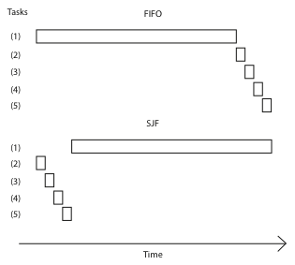
FIFO vs. SJF – Example showing extremes
If T1 = 10, T2..T5 = 1
Average response time =
(10+11+12+13+14)/5
= 12
If T1 = 10, T2..T5 = 1
Average response time =
(1+2+3+4+14)/5
= 4.8

Slide 19
Shortest Job First
Somehow need to predict future
How can we do this?
Some systems ask the user
When you submit a job, have to say how long it will take
To stop cheating, system kills job if takes too long
But: even non-malicious users have trouble predicting runtime of their jobs
Claim: SJF is optimal for average response time
Why? SJF always picks the shortest job; if it did not, then by definition it would result in higher average response time. <<see notes for details>>
For what workloads is FIFO optimal?
Why? FIFO is optimal for jobs that have identical characteristics in which case it does not matter who goes first.
Does SJF have any downsides?
Yes, SJF can lead to starvation because longer jobs would never get any allocated resources. Imagine a supermarket that implemented SJF!
Notes:
Consider a hypothetical alternative policy that is not SJF, but that we think might be optimal. Because the alternative is not SJF, at some point it will choose to run a task that is longer than something else in the queue. If we now switch the order of tasks, keeping everything the same, but doing the shorter task first, we will reduce the average response time.
Downsides: starvation, and variance in response time. Some task might take forever?
Imagine a supermarket that used SJF – would it work?
Clever person would go through with one item at a time…
Rich get richer, and poor get poorer = short jobs get through the system faster, long jobs take even longer

Slide 20
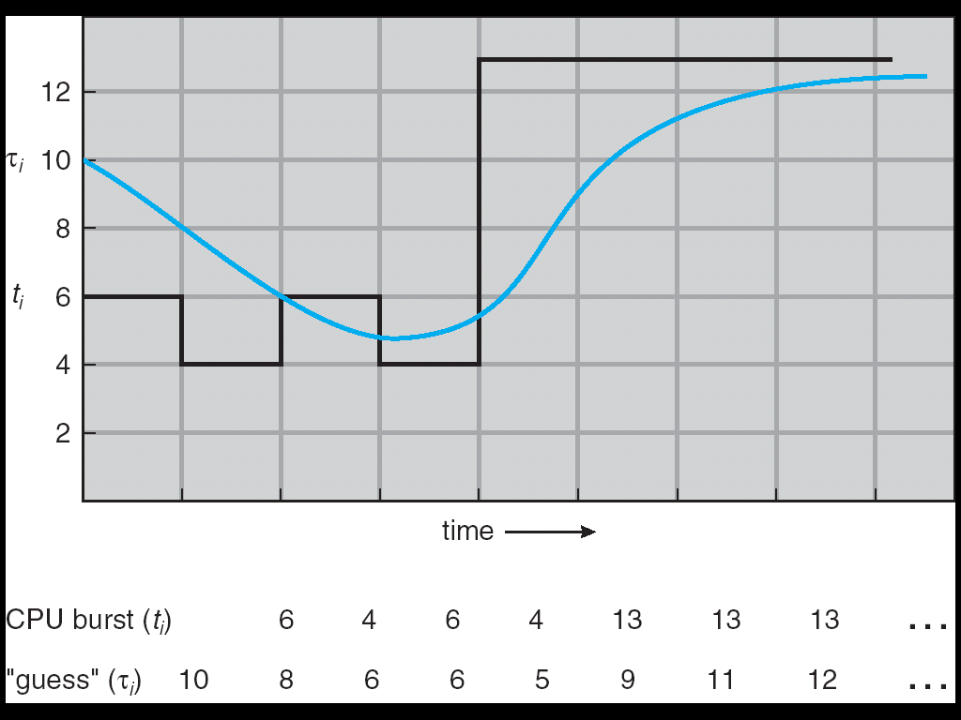
Predicting the Length of the Next CPU Burst
Adaptive: Changing policy based on past behavior
CPU scheduling, in virtual memory, in file systems, etc.
Works because programs have predictable behavior
If program was I/O bound in past, likely in future
If computer behavior were random, wouldn’t help
Example: SRTF with estimated burst length
Use an estimator function on previous bursts: Let t_{n-1}, t_{n-2}, t_{n-3}, etc. be previous CPU burst lengths. Estimate next burst τ_{n} = f(t_{n-1}, t_{n-2}, t_{n-3}, …)
Function f could be one of many different time series estimation schemes (Kalman filters, etc.)

Slide 21
P3: Round Robin
Each task gets resource for a fixed period of time (time quantum)
If task doesn’t complete, it goes back in line
Need to pick a time quantum
What if time quantum is too long?
Infinite?
Then it will be equivalent to FCFS or FIFO
What if time quantum is too short?
One instruction?
Too much overhead of swapping processes
Notes:
Can we combine best of both worlds? Optimal like SJF, but without starvation?

Slide 22
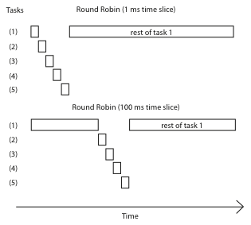
Round Robin

Slide 23
Round Robin vs. FIFO
Assuming zero-cost time slice, is Round Robin always better than FIFO?
No. Round robin is better for short jobs, but it is poor for jobs that are the same length.
What’s the worst case for Round Robin?
CPU devoted to Overhead
Notes:
Not really. Suppose we have 10 jobs, each takes 100 seconds of CPU time, and the time slice for the round robin is 1 second. Let us look at job completion times.
Job Completion Times
Job # FIFO Round robin
1 100 991
2 200 992
…
…
…
9 900 999
10 1000 1000
Although both round robin and FIFO finish at the same time, the average turnaround time is much worse under round robin than under FIFO. Therefore, round robin is better for short jobs, but it is poor for jobs that are the same length.
What’s the worst case for RR?

Slide 24
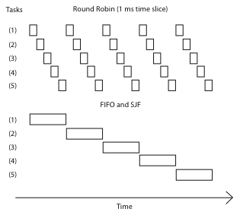
Round Robin vs. FIFO
Average Response Time
= (21+22+23+24+25)/5
= 23
Average Response Time
= (5+10+15+20+25)/5
= 15
Notes:
Everything is fair, but average response time in this case is awful – everyone finishes very late! In fact, this case is exactly when FIFO is optimal, RR is poor.
On the other hand, if we’re running streaming video, RR is great – everything happens in turn. SJF maximizes variance. But RR minimizes it.

Slide 25
Round Robin vs. Fairness
Is Round Robin always fair?
round robin ensures we don’t starve, and gives everyone a turn, but lets short tasks complete before long tasks
Notes:
Show of hands! After all, round robin ensures we don’t starve, and gives everyone a turn, but lets short tasks complete before long tasks.

Slide 26
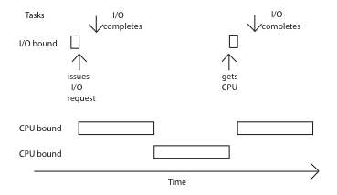
Mixed Workload
I/O task has to wait its turn for the CPU, and the result is that it gets a tiny fraction of the
performance it could get.
We could shorten the RR quantum, and that would help, but it would increase overhead.
What would this do under SJF
Every time the task returns to the CPU, it would get scheduled immediately!
Notes:
I/O task has to wait its turn for the CPU, and the result is that it gets a tiny fraction of the performance it could get.
We could shorten the RR quantum, and that would help, but it would increase overhead.
what would this do under SJF? Every time the task returns to the CPU, it would get scheduled immediately!

Slide 27
Max-Min Fairness
How do we balance a mixture of repeating tasks:
Some I/O bound, need only a little CPU
Some compute bound, can use as much CPU as they are assigned
One approach: maximize the minimum allocation given to a task
Schedule the smallest task first, then split the remaining time using max-min
Notes:
On previous slide, what would happen if we used max-min fairness? Then I/O task would be scheduled immediately – its always the one

Slide 28
Discussion
SJF is the best you can do at minimizing average response time
Provably optimal
Comparison of SJF with FCFS and RR
What if all jobs the same length?
SJF becomes the same as FCFS (i.e., FCFS is best can do if all jobs the same length)
What if jobs have varying length?
SJF (and RR): short jobs not stuck behind long ones

Slide 29
Example to illustrate benefits of SRTF
A or B
C
C’s
I/O
C’s
I/O
C’s
I/O
Three jobs:
A,B: CPU bound, each run for a week C: I/O bound, loop 1ms CPU, 9ms disk I/O
If only one at a time, C uses 90% of the disk, A or B use 100% of the CPU
With FIFO:
Once A or B get in, keep CPU for one week each
What about RR or SRTF?
Easier to see with a timeline

Slide 30
RR vs. SRTF
Disk Utilization:
9/201 ~ 4.5%
C
A
B
C
RR 100ms time slice
Disk Utilization:
~90% but lots of wakeups!
C’s
I/O
C’s
I/O
CABAB…
C
RR 1ms time slice
C’s
I/O
C’s
I/O
Disk Utilization:
90%
C
A
A
A
SRTF
C’s
I/O
C’s
I/O

Slide 31
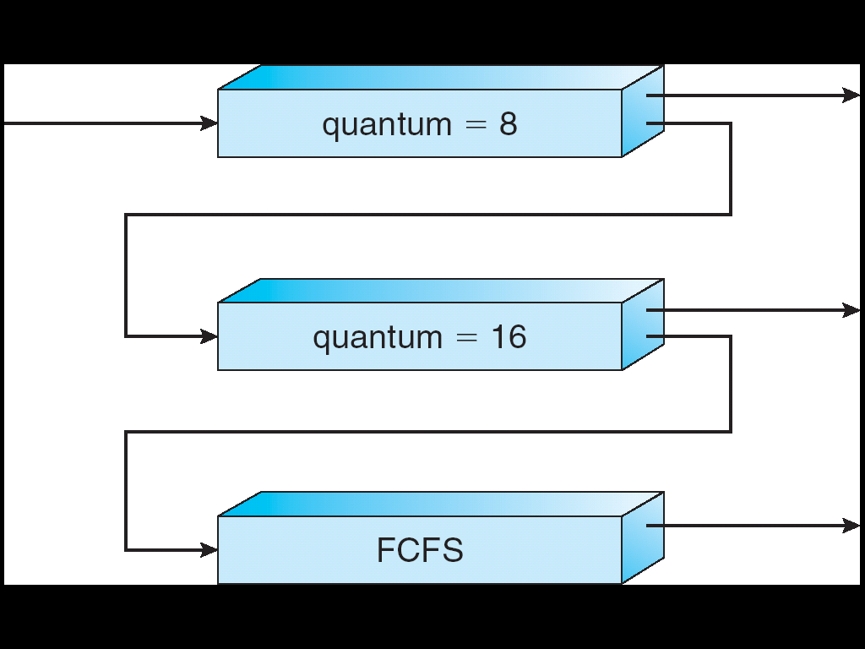
Multi-Level Feedback Scheduling
Long-Running
Compute tasks
demoted to low priority
Another method for exploiting past behavior
First used in Cambridge Time Sharing System (CTSS)
Multiple queues, each with different priority
Higher priority queues often considered “foreground” tasks
Each queue has its own scheduling algorithm
e.g., foreground – RR, background – FCFS
Sometimes multiple RR priorities with quantum increasing exponentially (highest:1ms, next:2ms, next: 4ms, etc.)
Adjust each job’s priority as follows (details vary)
Job starts in highest priority queue
If timeout expires, drop one level

Slide 32
Scheduling Details
Result approximates SRTF:
CPU bound jobs drop like a rock
Short-running I/O bound jobs stay near top
Scheduling must be done between the queues
Fixed priority scheduling:
Serve all from highest priority, then next priority, etc.
Time slice:
Each queue gets a certain amount of CPU time
e.g., 70% to highest, 20% next, 10% lowest

Slide 33
Countermeasure
Countermeasure: user action that can foil intent of the OS designer
For multilevel feedback, put in a bunch of meaningless I/O to keep job’s priority high
Of course, if everyone did this, wouldn’t work!
Ex: MIT Othello game project (simpler version of Go game)
Computer playing against competitor’s computer, so key was to do computing at higher priority the competitors.
Cheater put in printf’s, ran much faster!

Slide 34
Scheduling Fairness
What about fairness?
Strict fixed-priority scheduling between queues is unfair (run highest, then next, etc):
Long running jobs may never get CPU
In Multics, shut down machine, found 10-year-old job
Must give long-running jobs a fraction of the CPU even when there are shorter jobs to run
Tradeoff: fairness gained by hurting average response time!
How to implement fairness?
Could give each queue some fraction of the CPU
What if one long-running job and 100 short-running ones?
Like express lanes in a supermarket—sometimes express lanes get so long, get better service by going into one of the other lines
Could increase priority of jobs that don’t get service
What is done in UNIX
This is ad hoc—what rate should you increase priorities?

Slide 35
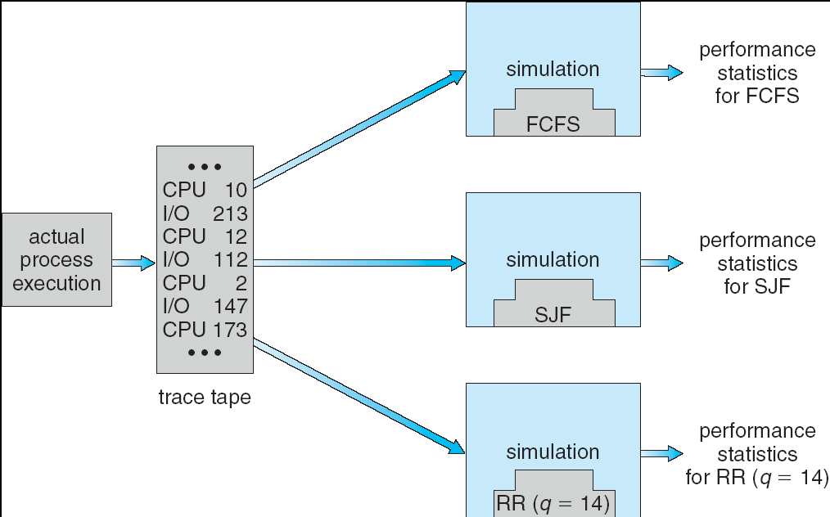
How to Evaluate a Scheduling algorithm?
Deterministic modeling
Takes a predetermined workload and compute the performance of each algorithm for that workload
Queuing models
Mathematical approach for handling stochastic workloads
Implementation/Simulation:
Build system which allows actual algorithms to be run against actual data. Most flexible/general.

Slide 36
A Final Word On Scheduling
When do the details of the scheduling policy and fairness really matter?
When there aren’t enough resources to go around
When should you simply buy a faster computer?
(Or network link, or expanded highway, or …)
One approach: Buy it when it will pay for itself in improved response time
Assuming you’re paying for worse response time in reduced productivity, customer angst, etc…
Might think that you should buy a faster X when X is utilized 100%, but usually, response time goes to infinity as utilization⇒100%
An interesting implication of this curve:
Most scheduling algorithms work fine in the “linear” portion of the load curve, fail otherwise
Argues for buying a faster X when hit “knee” of curve
Response time
100%
Utilization

Slide 37
Summary
FCFS is simple and minimizes overhead.
If tasks are variable in size, then FCFS can have very poor average response time.
If tasks are equal in size, FCFS is optimal in terms of average response time.
Considering only the processor, SJF is optimal in terms of average response time.
SJF is pessimal in terms of variance in response time.

Slide 38
Summary (contd.)
If tasks are variable in size, Round Robin approximates SJF.
If tasks are equal in size, Round Robin will have very poor average response time with short time slices.
Tasks that intermix processor and I/O benefit from SJF and can do poorly under Round Robin.
Round Robin avoids starvation.
By manipulating the assignment of tasks to priority queues, an MFQ scheduler can achieve a balance between responsiveness, low overhead, and fairness.

